Slide 1


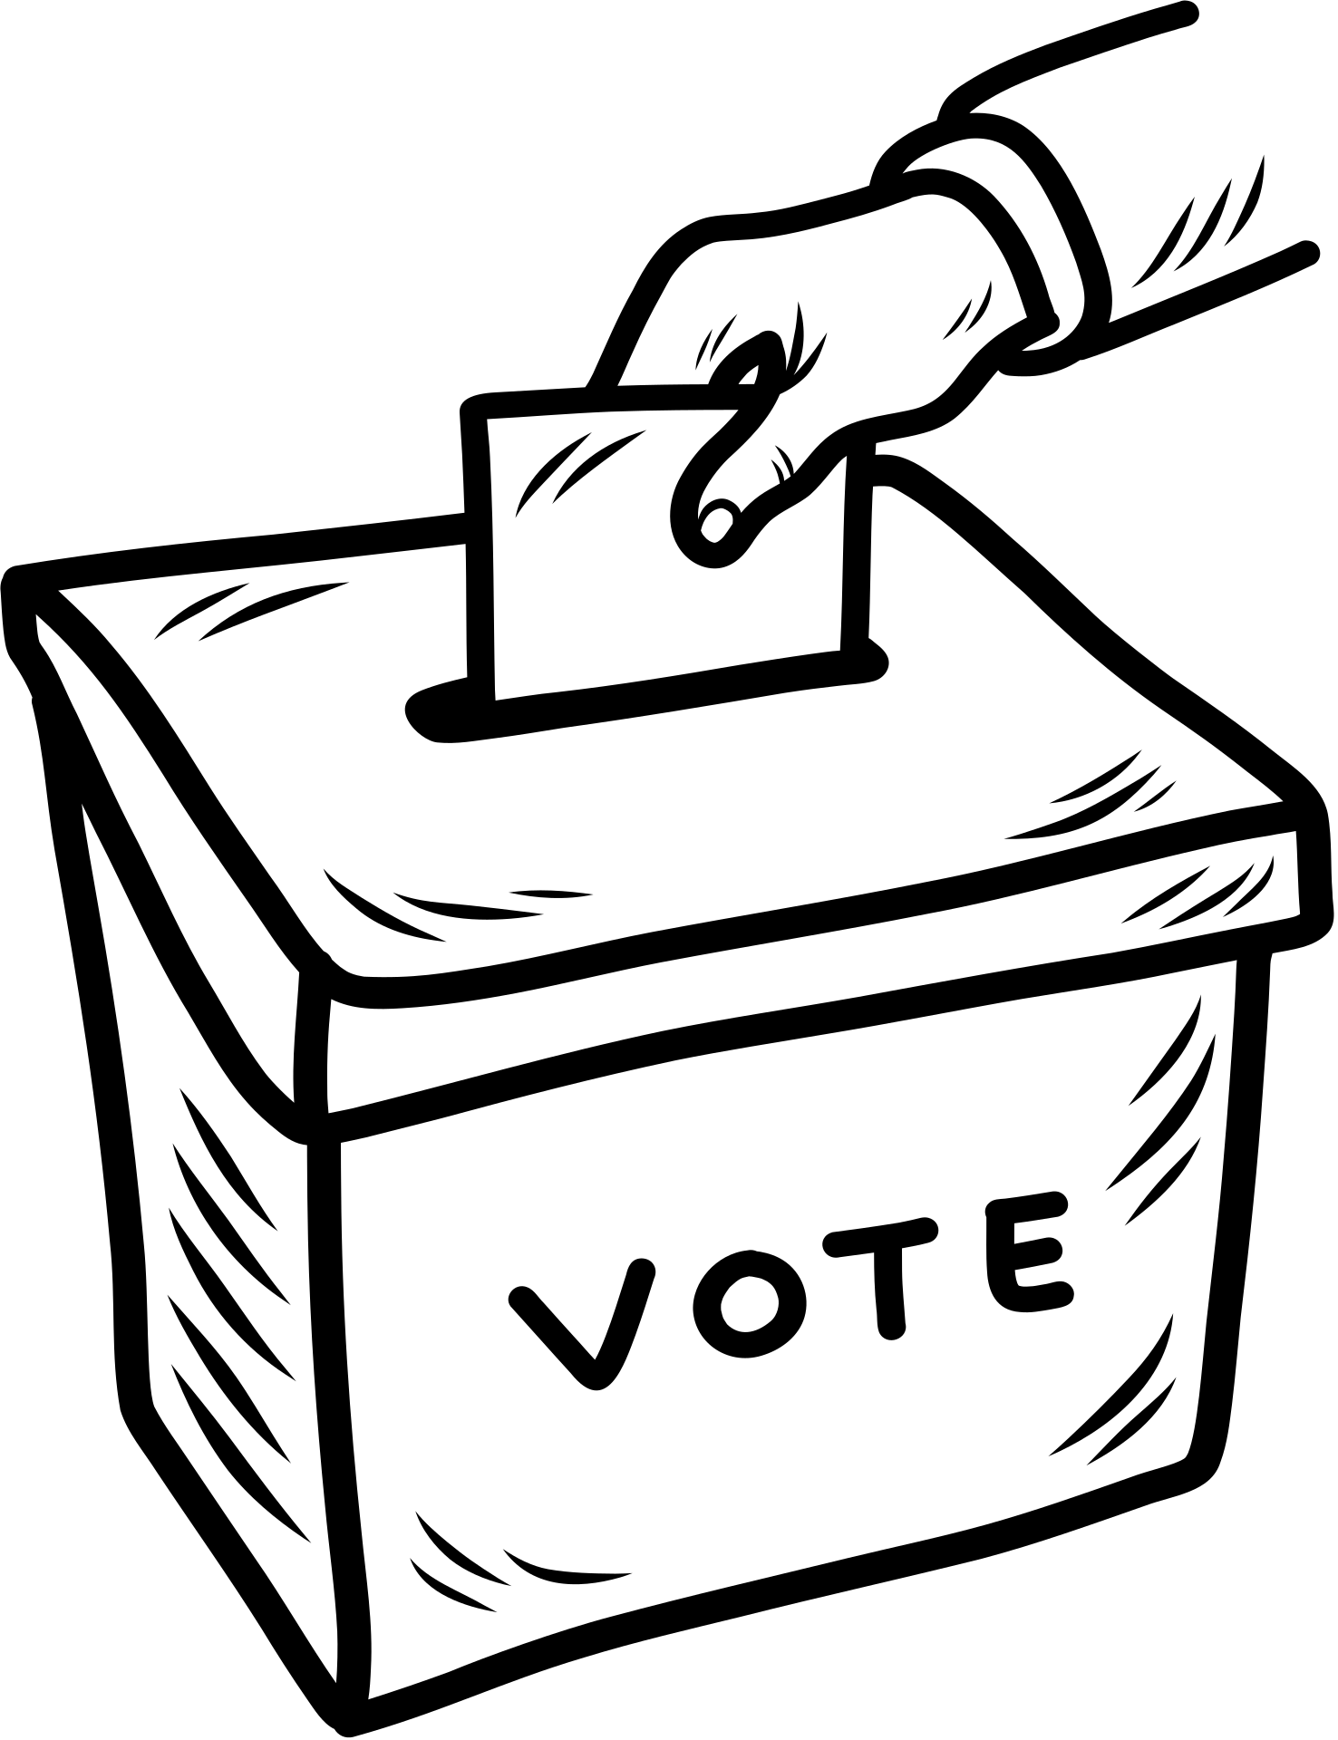




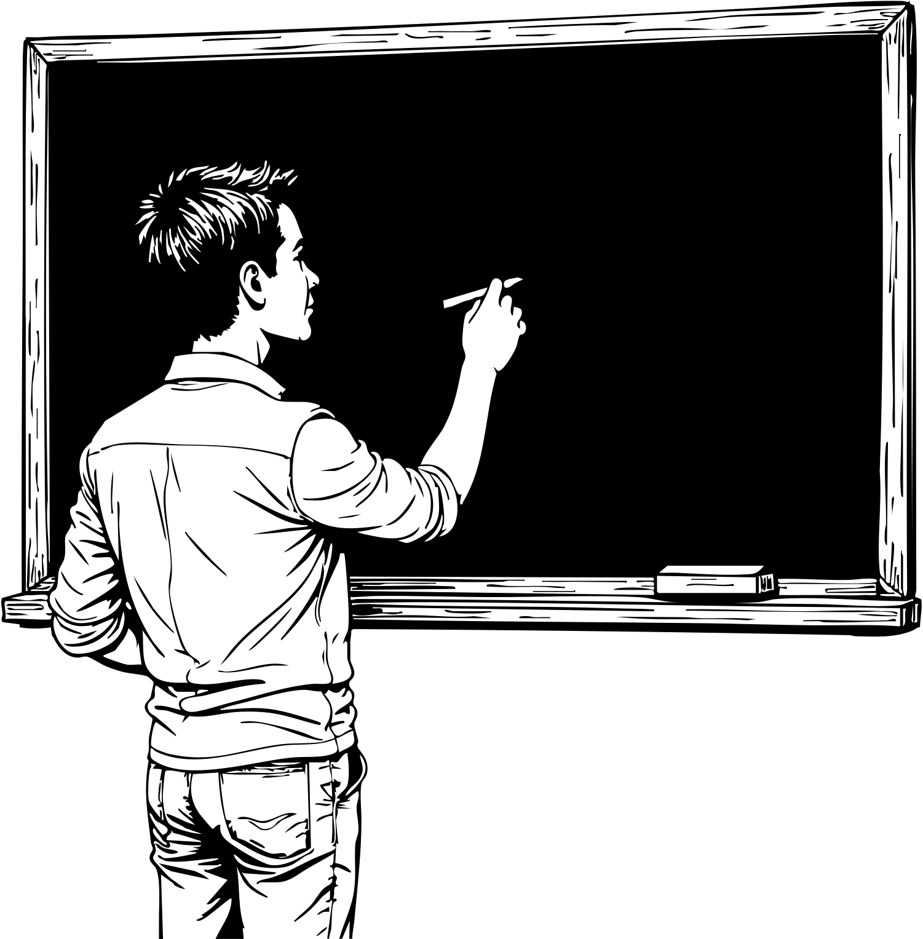

STRUCTURED PROGRAMMING LANGUAGES LAB
COURSE CODE: 0613-102
BALLOTE FREEDOM
Presented By:
Presented To:
02. Mosaddek Hossain Mehedi
17. Saiful Islam
21. Hasibul Hoque Probal
22. Mst. Sultana Yeasmin Suma
40. Azizur Rahman Arzu
Antu Chowdhury
Lecturer
Department of CSE
Dhaka International University
"The best argument against democracy is a five-minute conversation with the average voter, but the best argument for it is that all the others are worse."
- WINSTON CHURCHILL

Slide 2


1
INTRODUCTION
BALLOTE​‍​‌‍​‍‌ FREEDOM is a simple console based project of C programming that effectively provides a way to conduct elections that would be efficient, accountable, and transparent at a small scale by simulating a basic election ​‍​‌‍​‍‌process.
"Democracy is not just the right to vote, it is the right to live in dignity."
– NAOMI KLEIN

Slide 3
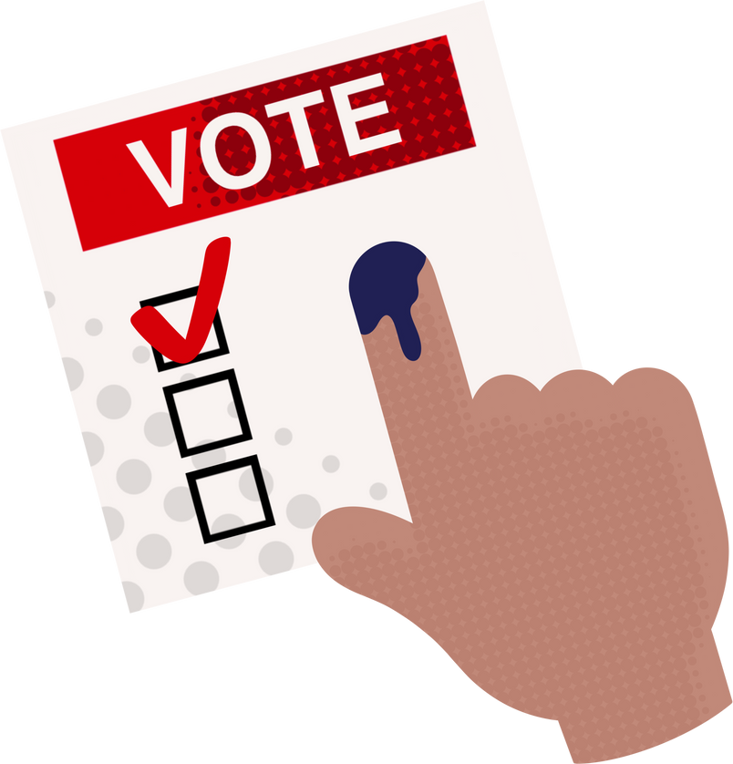
2
OBJECTIVES
  Designing a simple & interactive voting system.
  Applying of functions, arrays, loops & string in C.
  Ensuring accurate vote counting & result display without compromising transparency.
  Implementing basic data validation & decision-making logic.
"In a democracy, the highest office is the office of citizen."
– FELIX FRANKFURTER

Slide 4
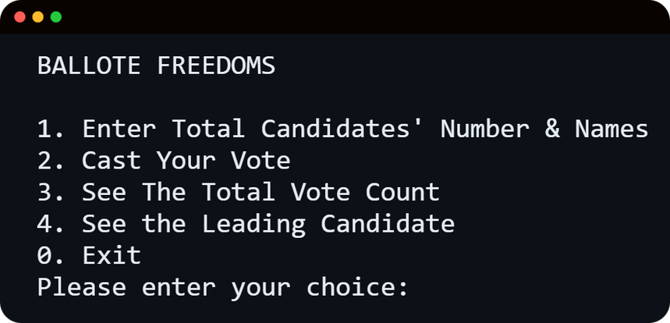
3
SYSTEM FEATURES
  Insert & save candidate names.
  Casting votes for preferred candidate.
  Showing total vote count.
  Showing the leading candidate’s name.
  Handling spoiled votes.
"Democracy cannot succeed unless those who express their choice are prepared to choose wisely."
- FRANKLIN D. ROOSEVELT

Slide 5

4
PROGRAM STRUCTURE
  Language: C Programming
  Compiler: GCC / Code::Blocks / Dev-C++ / VS Code / Online Compiler
  Concepts: Loops, Functions, Arrays, Conditional Statements, String
"Democracy is not a spectator sport. It is a participatory event."
- MARIAN WRIGHT EDELMAN

Slide 6

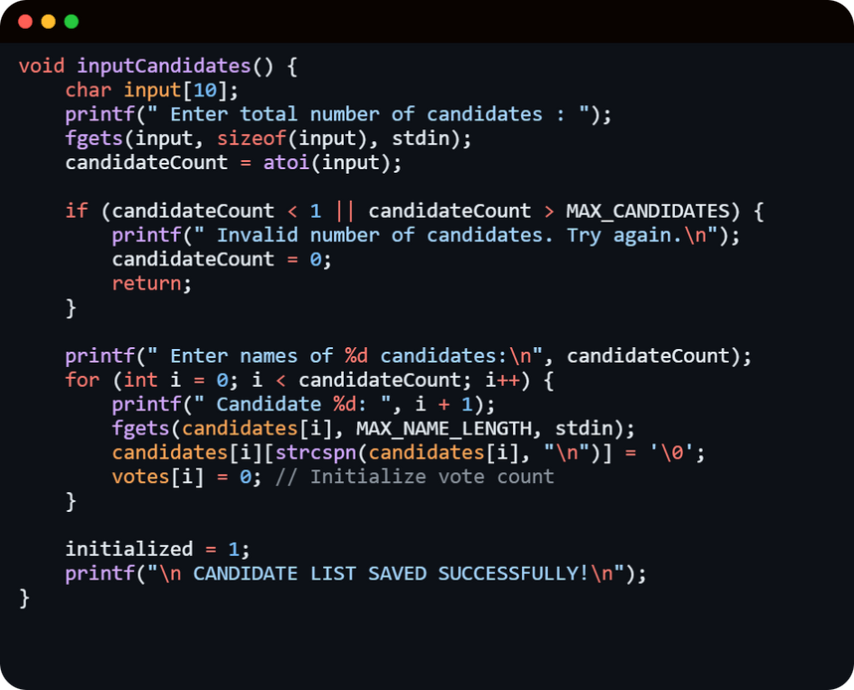
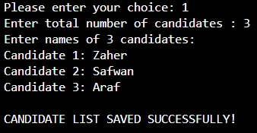
5
FUNCTIONALITIES
Initializing candidates: inputCandidates()​‍​‌‍​‍‌ is a function that collects and stores candidates information in a way that ensures the validity of the input and makes the program ready for the voting process by using temporary variables, conditional and loop ​‍​‌‍​‍‌statements.
"The ignorance of one voter in a democracy impairs the security of all."
- JohN F. KENNEDY

Slide 7
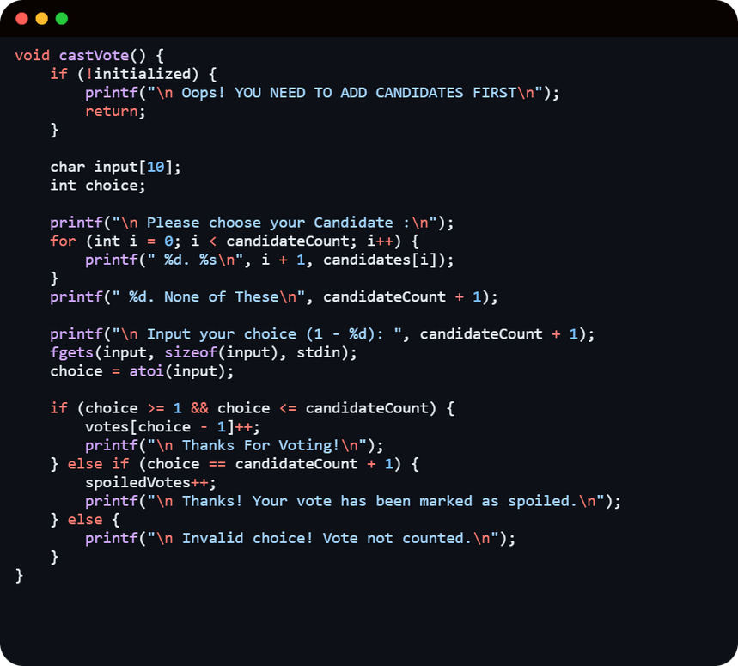
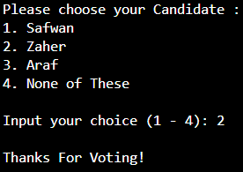
6
FUNCTIONALITIES
Vote cast: castVote() lets the user to vote for the preffered candidate using getfunction, checks if the choice is valid using conditional statement & updates either the candidate’s vote count or the spoiled vote count.
"Bad officials are elected by good citizens who do not vote."
- George JEAN NATHAN

Slide 8
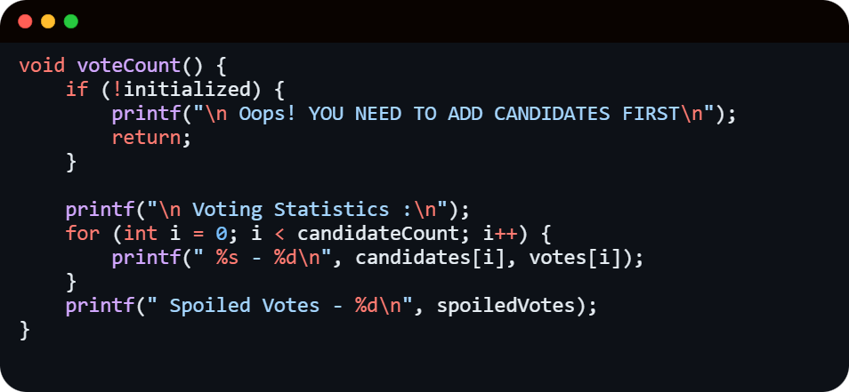
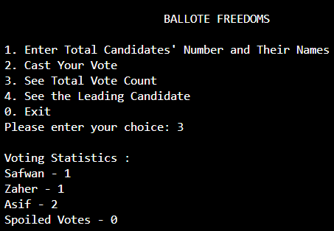
7
FUNCTIONALITIES
Displaying total vote count: voteCount()​‍​‌‍​‍‌ displays the election results by printing the count of each candidate's votes & the number of spoiled votes through a Loop statement, thus it makes sure that the output is shown only after the candidates have been correctly ​‍​‌‍​‍‌initialized.
"Our lives begin to end the day we become silent about things that matter."
— MartiN LUTHER KING JR.

Slide 9
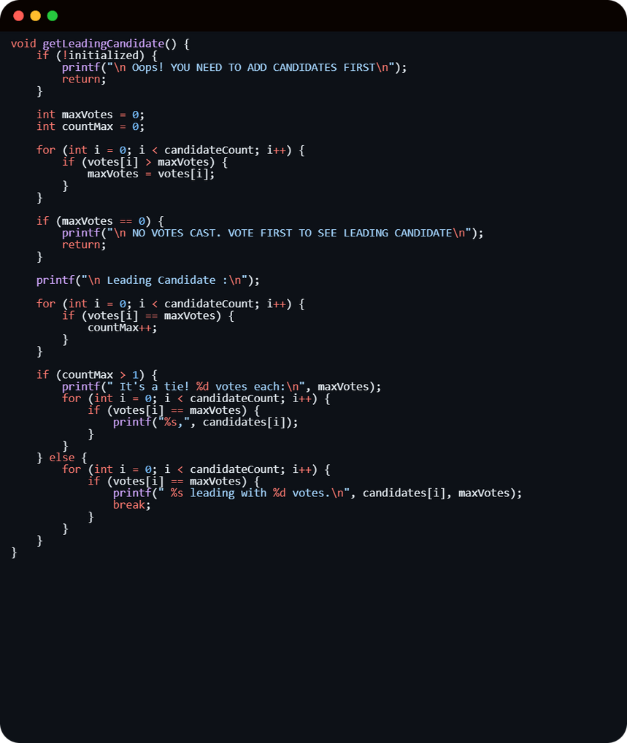
8
FUNCTIONALITIES
Displaying result: getLeadingCandidate() determines the leading candidate.
"Democracy is the art & science of mobilizing the entire physical, economic & spiritual resources of the people."
- FrANKLIN D. ROOSEVELT

Slide 10
9
FUTURE ENHANCEMENT
  Preventing duplicate candidate names.
  Saving the result as a text file.
  Show voting percentages of candidate & spoiled votes.
  Reset all processes & restart the voting procedure from the begaining.
"Tomorrow depends on today’s decision."
- John D. Rockefeller

Slide 11
10
CONCLUSION
  BALLOTE FREDOM is a simple voting system developed using C Programming.
  It efficiently handles candidate registration, vote casting & result calculation using basic programming constructs such as arrays, functions & conditional statements.
  The system demonstrates practical implementation of data handling along with user interaction in C.
  Next development stages could feature adding data storage, user authentication and a graphical interface for better ​‍​‌‍​‍‌functionality.
"Democracy thrives when people are willing to stand up for what is right, even when it’s not easy."
- H. L. MENCKEN

Slide 12
Thank You!
"Let us remind ourselves that our freedom is incomplete without the right to vote."
- Nelson MANDELA

